Slide 1

ONLINE LEAVE MANAGEMENT SYSTEM
BATCH 2021-5863
Enrollment Number | Name of the Student
EBEONO721410307 | Md Ghouse Pasha
EBEON0721407299 | Rahul Murugesan
EBEON0721408001 | K.Gopal
EBKPRM0721403303 | B.Srithan Reddy
Under the guidance of
E Santosh Mali (Java Trainer)

Slide 2

ONLINE LEAVE MANAGEMENT SYSTEM
Contents:
Introduction
Modules
Technologies
Advantages
Conclusions

Slide 3
Introduction
The main objective of the Proposed System is to Decrease the paper work and easier record maintance by having a particular website for leaves maintance.
This Approach Basically deals with the record of leaves taken by employees and other higher officials for the approval of leave .
Leave Management Sytem(LMS) is designed to help the organization to set up employee leave policy & manage their leaves seamlessy.This software enables configuring all types of leaves,including paid leaves,leaves without pay,sick leaves,causal leaves,medical leaves, and much more.In addition to this,the software also helps an employee to check the status of leave,daily attendence record,and can also apply for leave.

Slide 4
Modules
Home
Sign-Up
Employees
Management
Director

Slide 5
Home
Home Page Developed by K.Gopal
A Home Page is the main web page of a website.

Slide 6
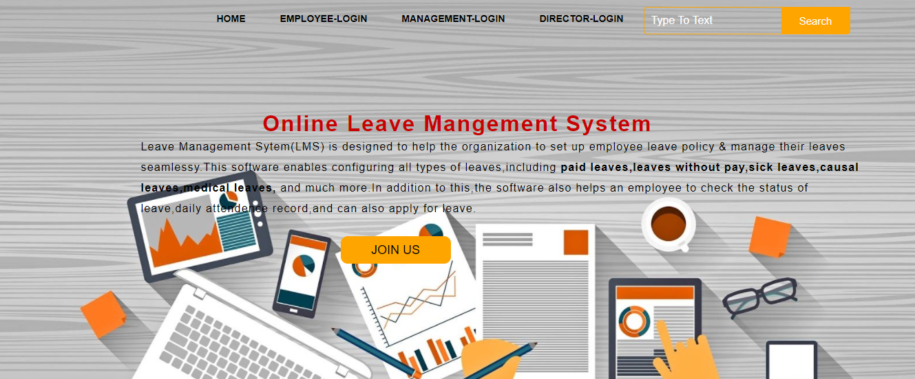
Home Page

Slide 7
Sign-Up
Sign-Up Page Developed by Rahul Murugesan
It used for Register Purpose of the New Employee in Organization

Slide 8
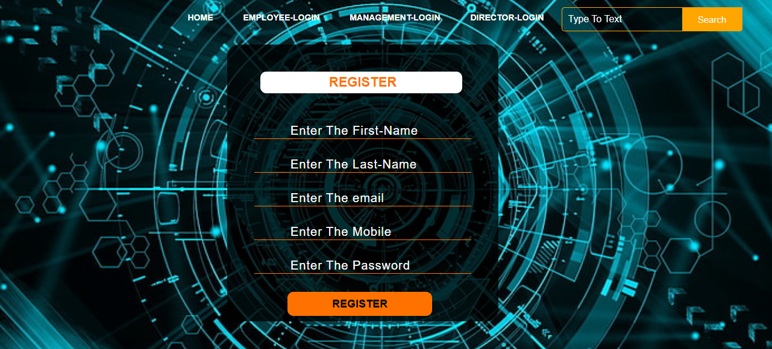
Sign-Up Page

Slide 9
Employee Login
Employee Login Page Developed by B Srithan reddy
This page is used for Purpose of Employee login to apply leave and to check the leave status

Slide 10
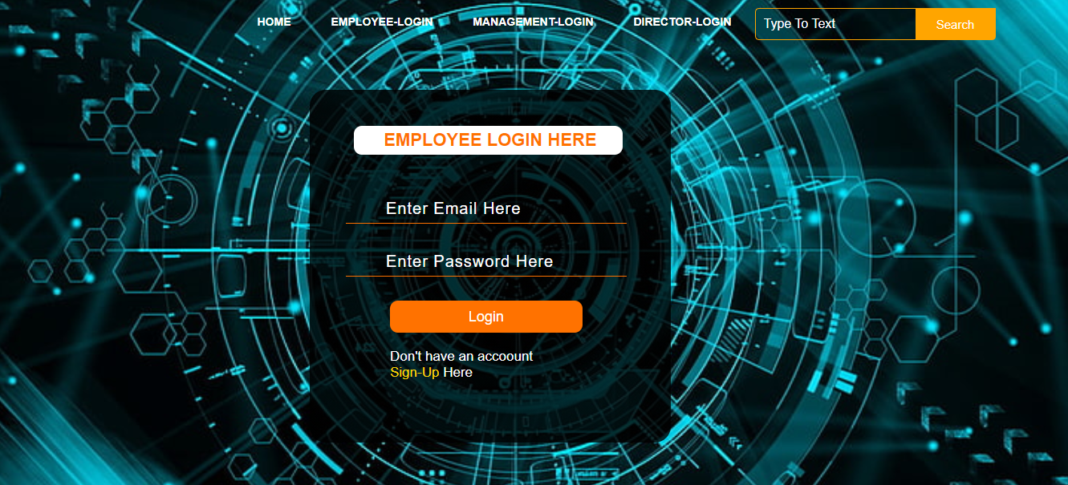
Employee Login Module

Slide 11
Management Login
Management Page is Developed by Md Ghouse Pasha
It is Used for Management login and to check the leave applications of employees
It is used to Accept or Reject leave of the employees

Slide 12
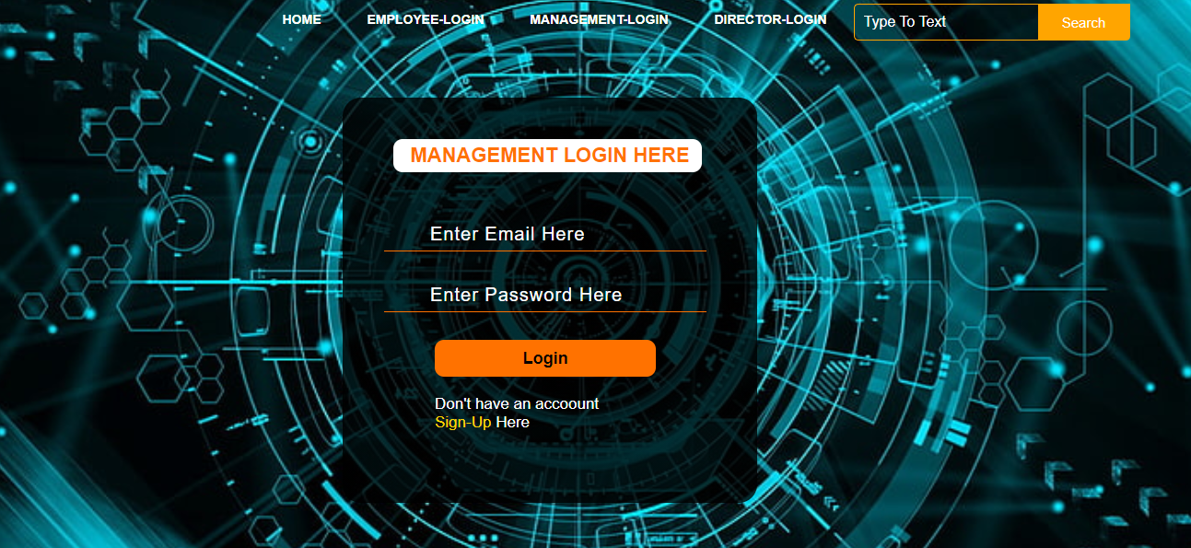
Management-Login Module

Slide 13
Director Login
Management Page is Developed by Md Ghouse Pasha
This page is used for login purpose of high officials of the organization
To check the status of the employees and management

Slide 14
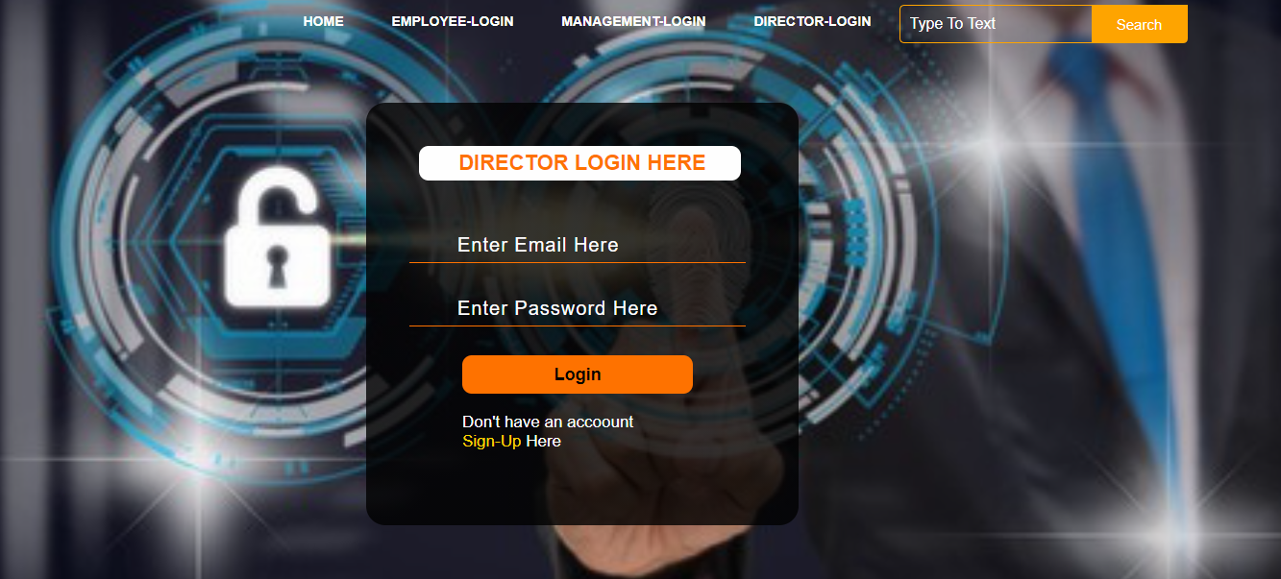
Director-Login Module

Slide 15
Technologies
HTML
CSS
JavaScript

Slide 16
Advantages
The Software is system independent it works on internet can be used even if the requestor/sanctioning authority is located in different country.
Entire process is documented on E-mails.
Eliminates the paper works and need not contact the officials.

Slide 17
Conclusions
Leave management system is very useful for any organization to maintain leave record of the employees.This system not only maintains the leave of employees it also maintain the leave application of the employees.
The higher authorities may accept or reject the leave application requested by employee.Thus this system reduce the excess amount of paper work job done by organization to maintain the leave.

Slide 18

Thank You

